Slide 1




Weekly report: Team Project Development
Week number: 12
Date: 16/11/2025
Supervisor: Dr. Marina Blohm
Group members: Ahmed Sallam, Luis Urhahn, Ceren Cetin, Sohail Mansuri
Presenter: Ahmed Sallam
1
Project Development / Optimus Syria

Slide 2

Weekly progress of the team
Update the wind turbine capital cost
Teams updated price contributions
Optimization of feasibility study
Finalize the cost analysis
Scan me
15/12/2025
2
Ahmed Sallam
Project Development / Optimus Syria
2

Slide 3
Progress AEP simulation
Park Calculation with shadow curtailment:
Parameter | Unit | Value
Result Park (AEP) (no loss) | MWh/year | 22 491.8
Result Park (AEP) | MWh/year | 21 908.8
Capacity factor | % | 50
Full Load Hours (FLH) | Hours/year | 4 382
Average wind speed | m/s | 8.5
Curtailment loss | % | 2.6
Including the shadow restriction:
30 min before sunrise to 30 min after sunrise → shutdown of turbine
15/12/2025
3
Ahmed Sallam
Project Development / Optimus Syria
3

Slide 4
Progress AEP simulation
Park Calculation (w/o curtailments):
Park Calculation (with curtailments):
Parameter | Unit | Value
Result Park (AEP) | MWh/year | 22 491.8
Capacity factor | % | 51.3
Full Load Hours (FLH) | Hours/year | 4 498
Average wind speed | m/s | 8.5
Curtailment loss | % | 0.0
Parameter | Unit | Value
Result Park (AEP) | MWh/year | 21 908.8
Capacity factor | % | 50
Full Load Hours (FLH) | Hours/year | 4 382
Average wind speed | m/s | 8.5
Curtailment loss | % | 2.6
15/12/2025
4
Ahmed Sallam
Project Development / Optimus Syria
4

Slide 5
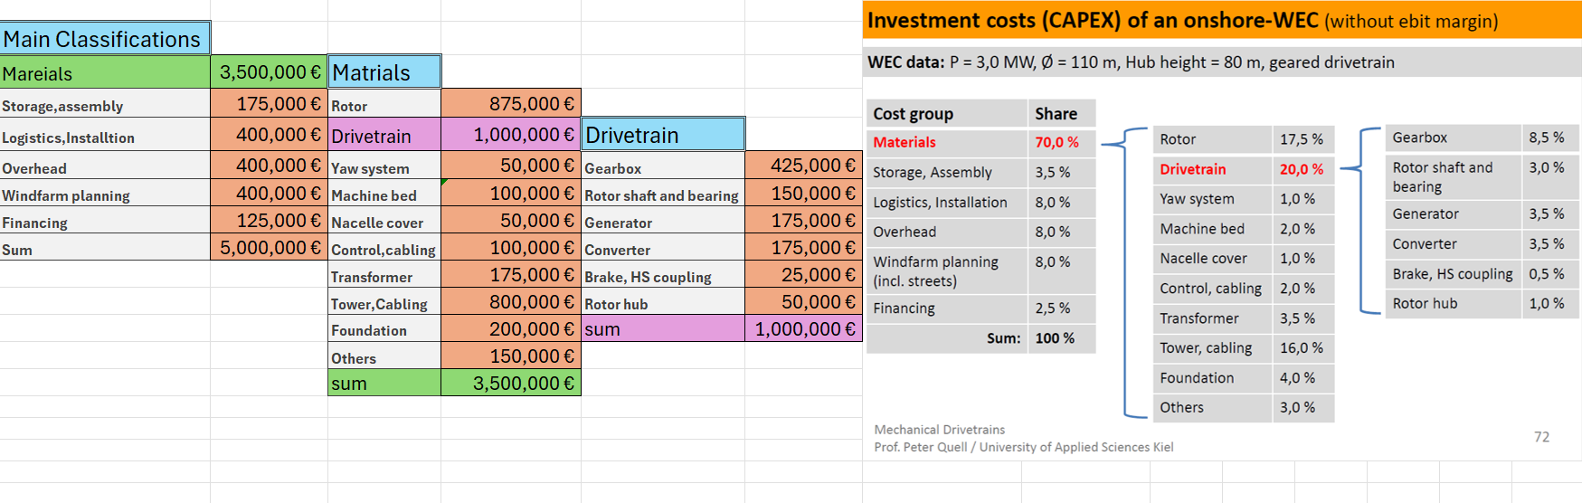
Initial price contributions
5
Notes:
Shows the distances to the surrounding buildings.
In general the distance is longer to the surrounding buildings, especially in the main wind dirction, which is cruicual!
Regarding the buildings A, the shaddow flicker will be a problem, but only in the morning ours.
With the buildings F-H, I am not sure if they are in use. I assume its for farmers or so.
In my opinion its the better side now. Only the amount of water resources could be a major problem, but according to the soil analysis it will not be a problem!

Slide 6
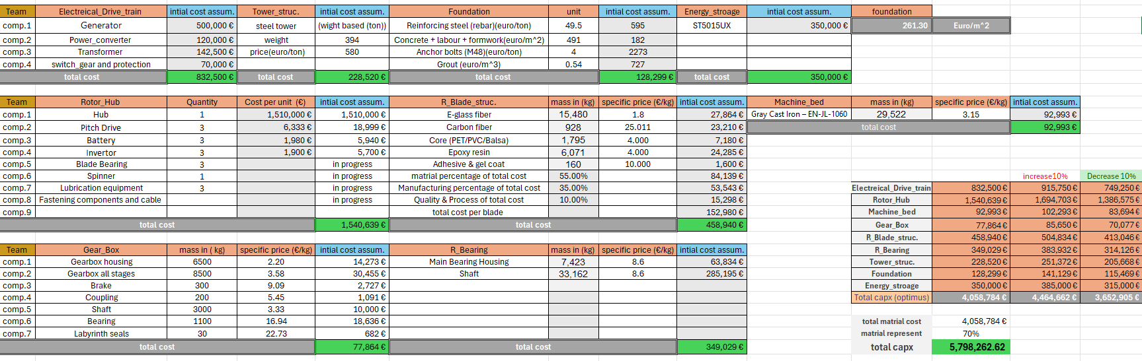
Update the wind turbine Capex cost
6
Ahmed Sallam
Project Development / Optimus Syria

Slide 7
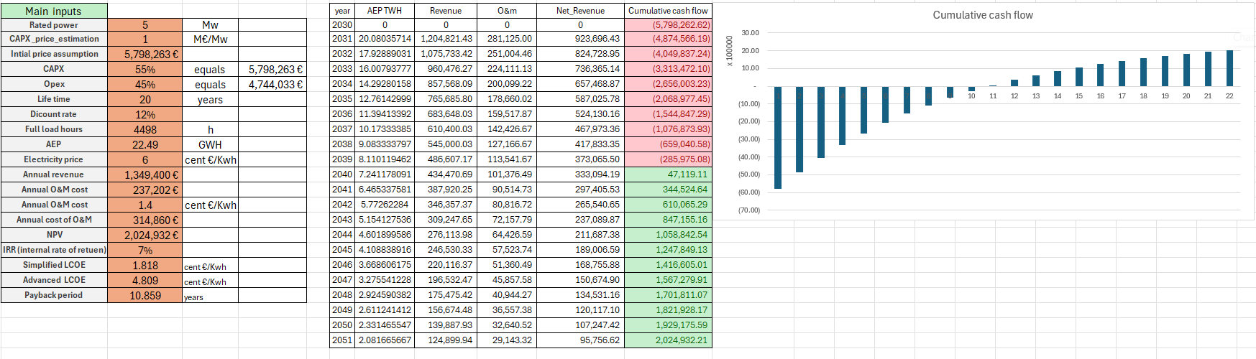
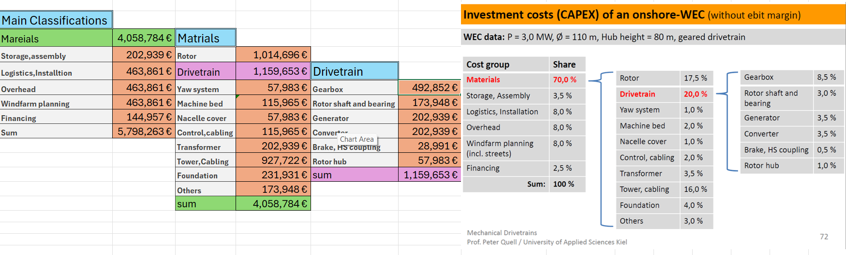
Finalize the cost analysis
7
Ahmed Sallam
Project Development / Optimus Syria
7

Slide 8
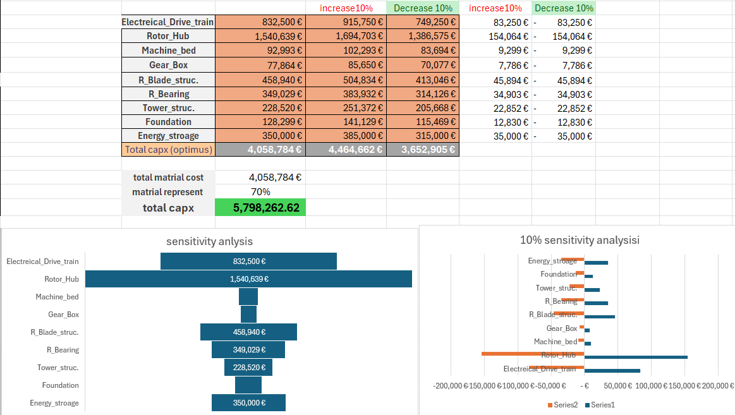
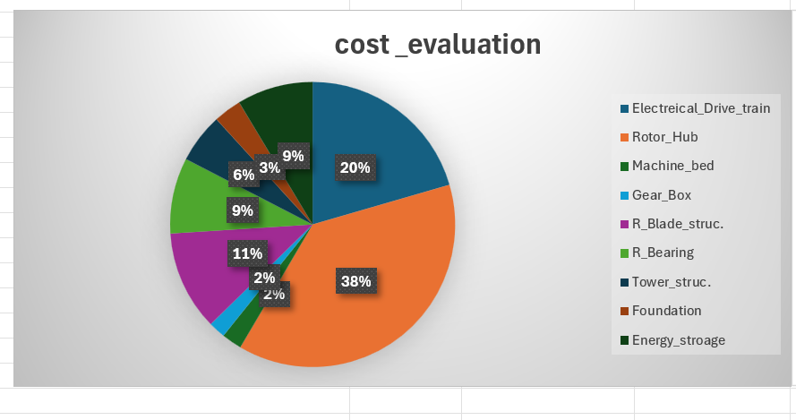
Optimization of feasibility study
Scan me
8

Slide 9
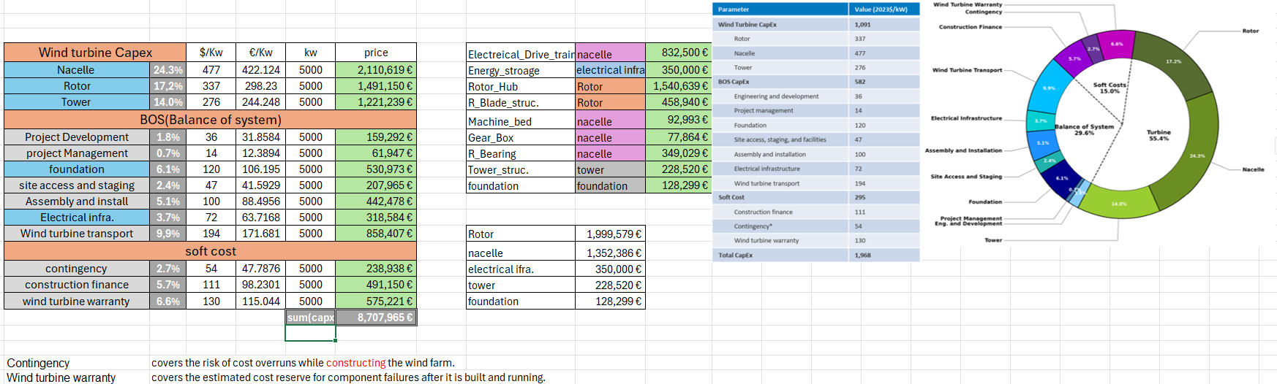
Benchmark for cost of wind energy
https://docs.nrel.gov/docs/fy25osti/91775.pdf
9
Project Development / Optimus Syria

Slide 10
Finalize the cost analysis
Recontacting teams with overloaded prices
Searching for finance from banks
Terms and conditions of the bank and the Profts on the loan required
Available Banks for renewable energy investment
10

